Slide 1
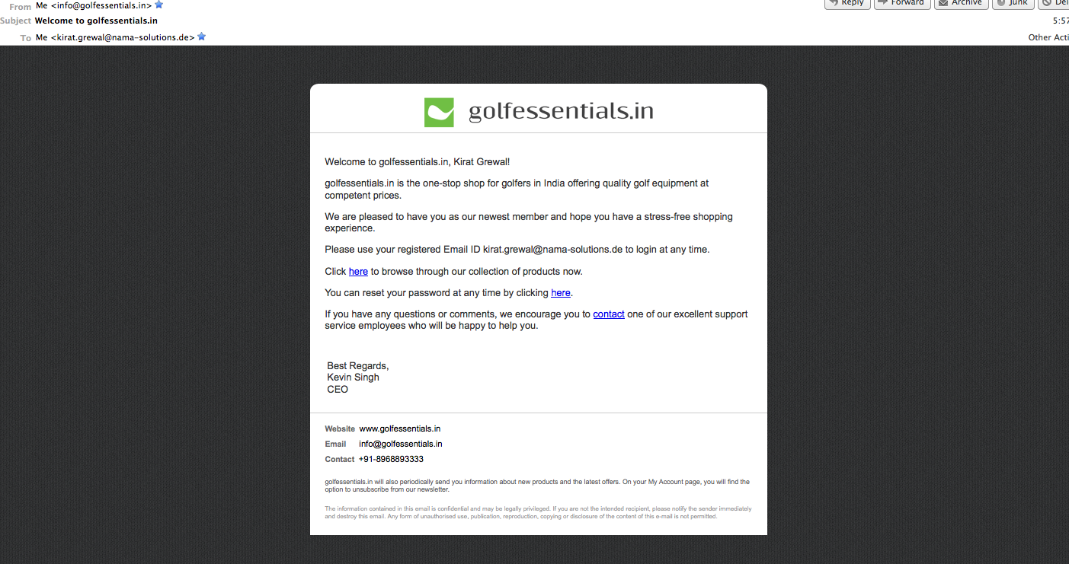
On registering: From: info@golfessentials.in Subject: Welcome to golfessentials.in
ok

Slide 2
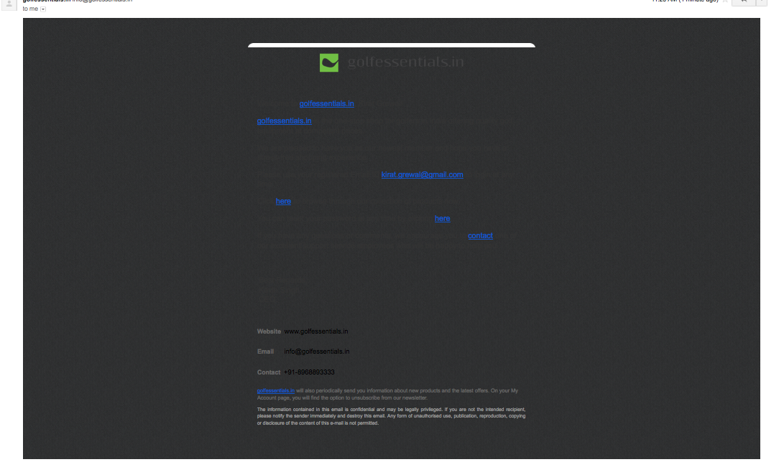
Email received on gmail today (Wednesday, 7 Nov 12). Can we add a link to view the content on the browser? What are the other alternatives? A link to “View in Browser” should be added anyway – It can’t be added because the information being generated is dynamic [ email Id, username etc is coming from the database ] in nature and it can’t be stored in an email client for a receiver to click it anytime and open it in a browser.

Slide 3
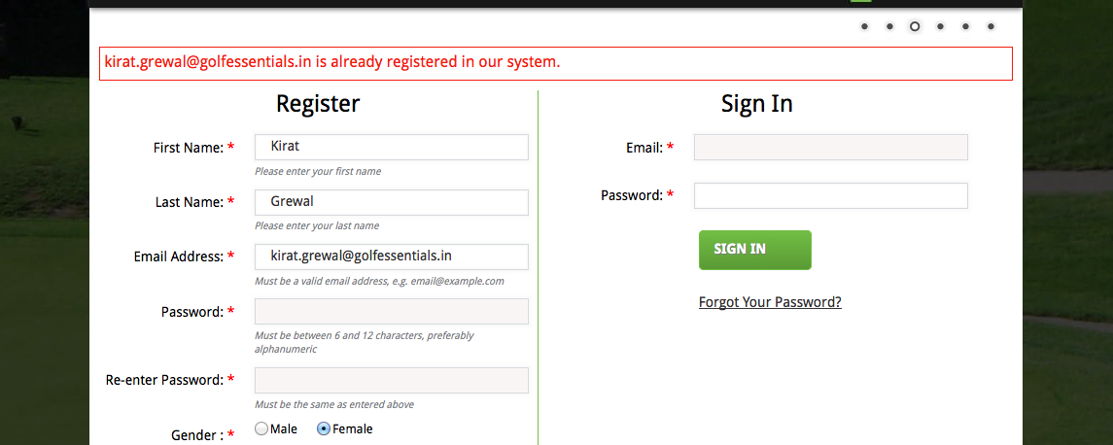
This entire sentence should be hyperlinked Corrected
Forgot your password? We’ll email it to you

Slide 4
On the website – on registering
Re-direction to landing page
ok

Slide 5
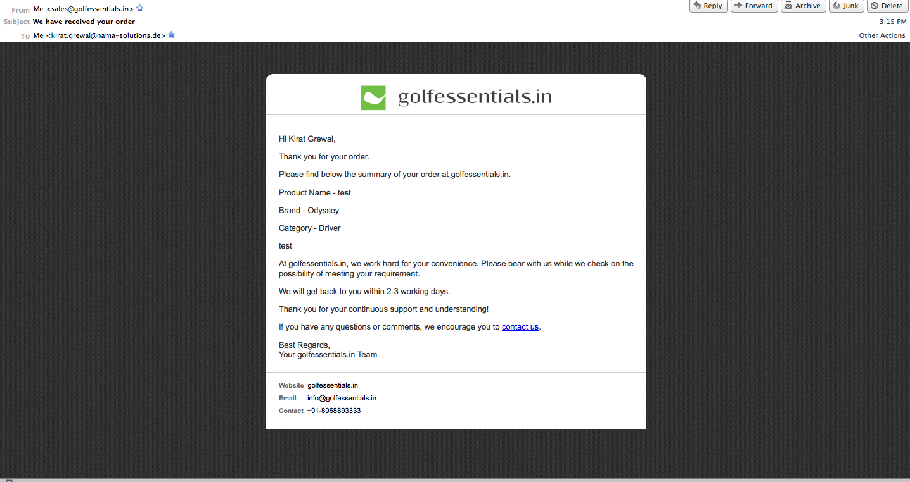
On receiving a Special Order: From: sales@golfessentials.in Subject: We have received your order
ok

Slide 6
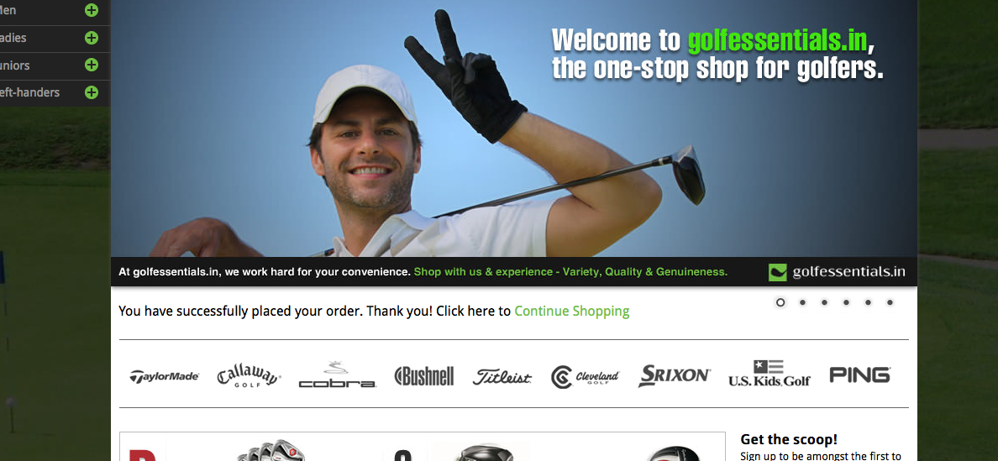
‘here’ should be hyperlinked, and not ‘Continue Shopping’ ok

Slide 7
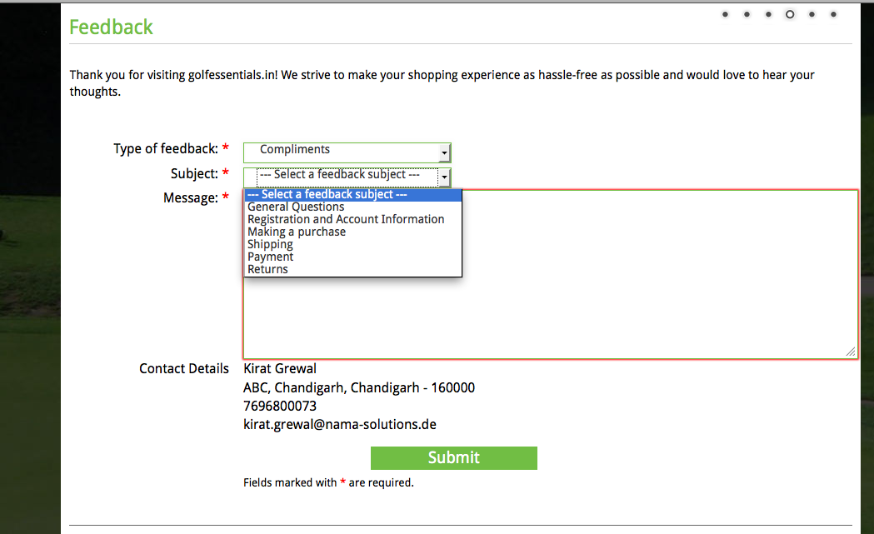
Availability of products (3)
Support Service (5)
ok

Slide 8
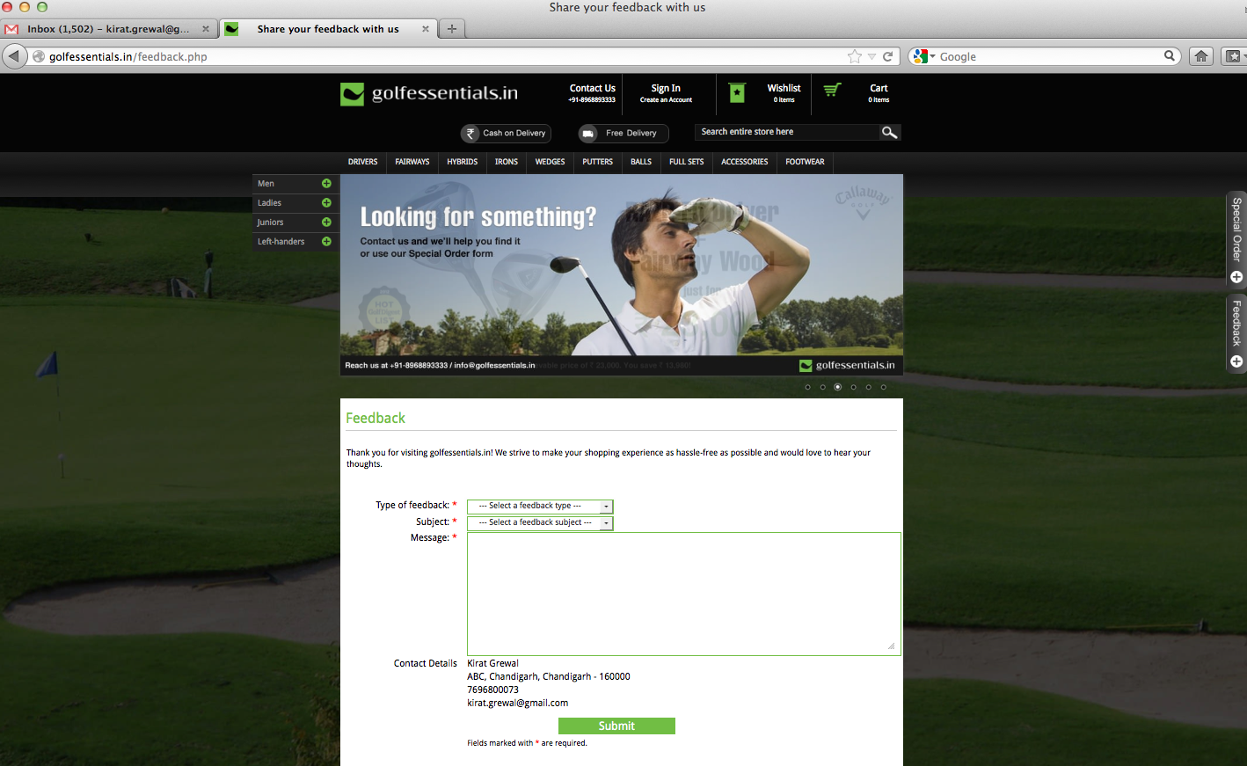
My details are appearing after having signed out (working with only one tab) – Couldn’t replicate it !

Slide 9
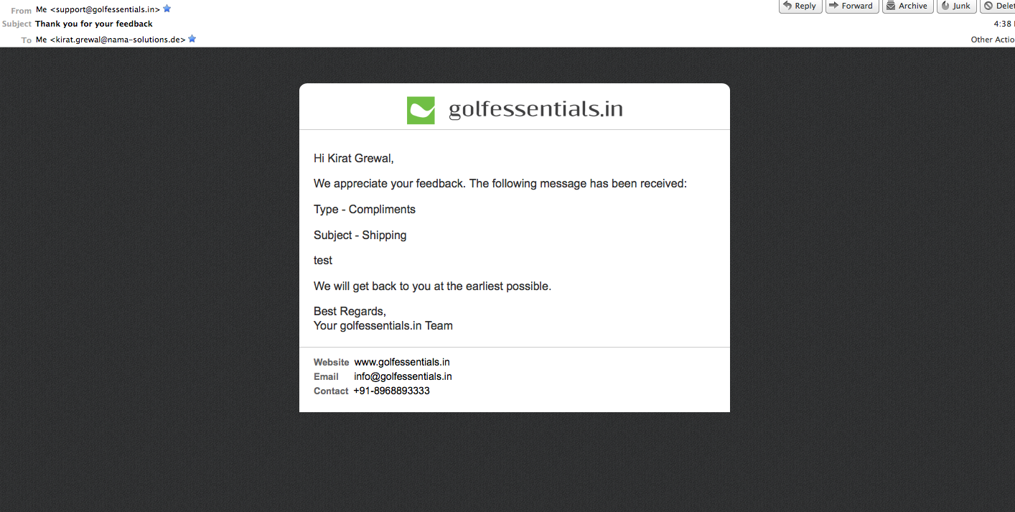
On receiving feedback: From: support@golfessentials.in Subject: Thank you for your feedback
ok

Slide 10
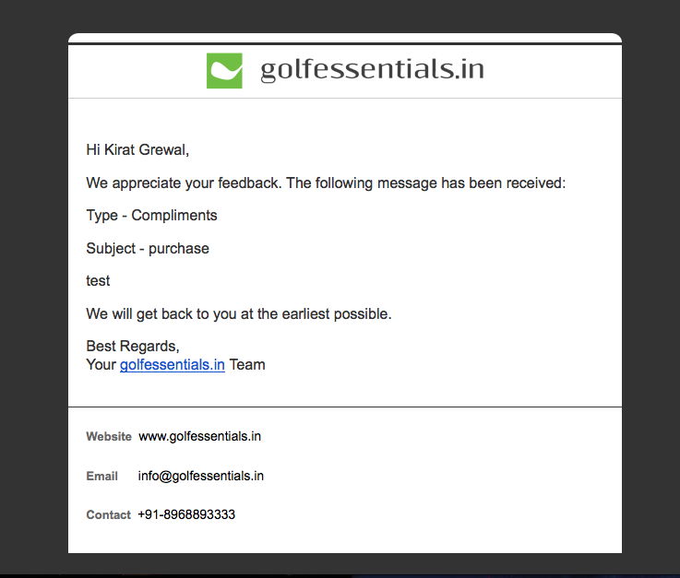
This is incomplete Corrected

Slide 11
On the website
Your feedback has been received. Thank you! Click here to continue shopping.
ok

Slide 12
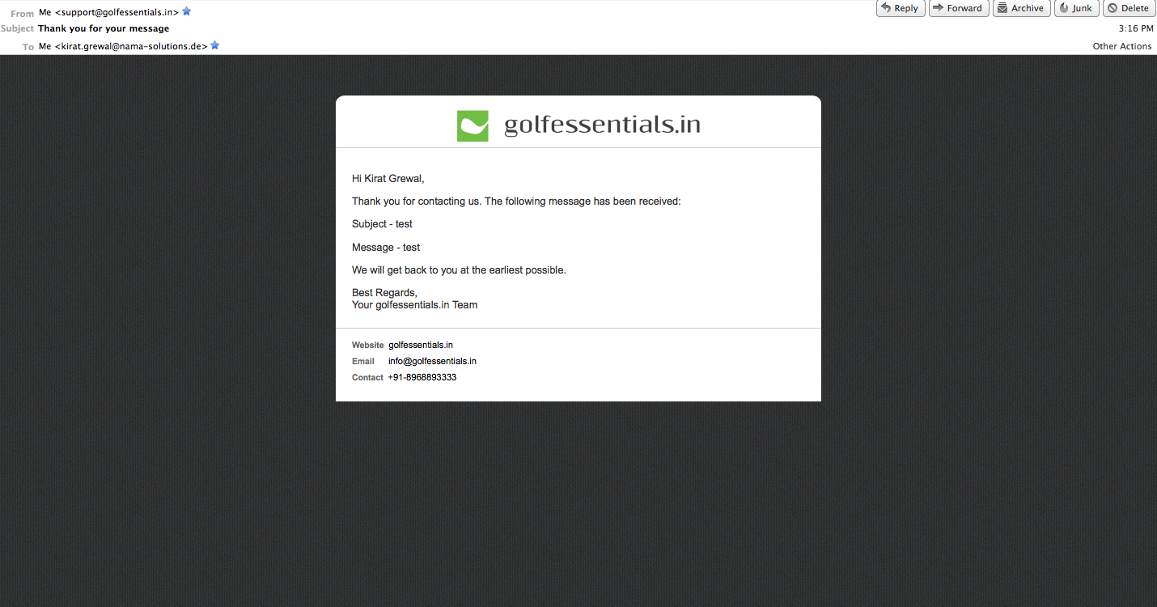
On receiving a message through contact us: From: support@golfessentials.in Subject: Thank you for your message
ok

Slide 13
On the website
Your message has been received. Thank you! Click here to continue shopping. Corrected

Slide 14
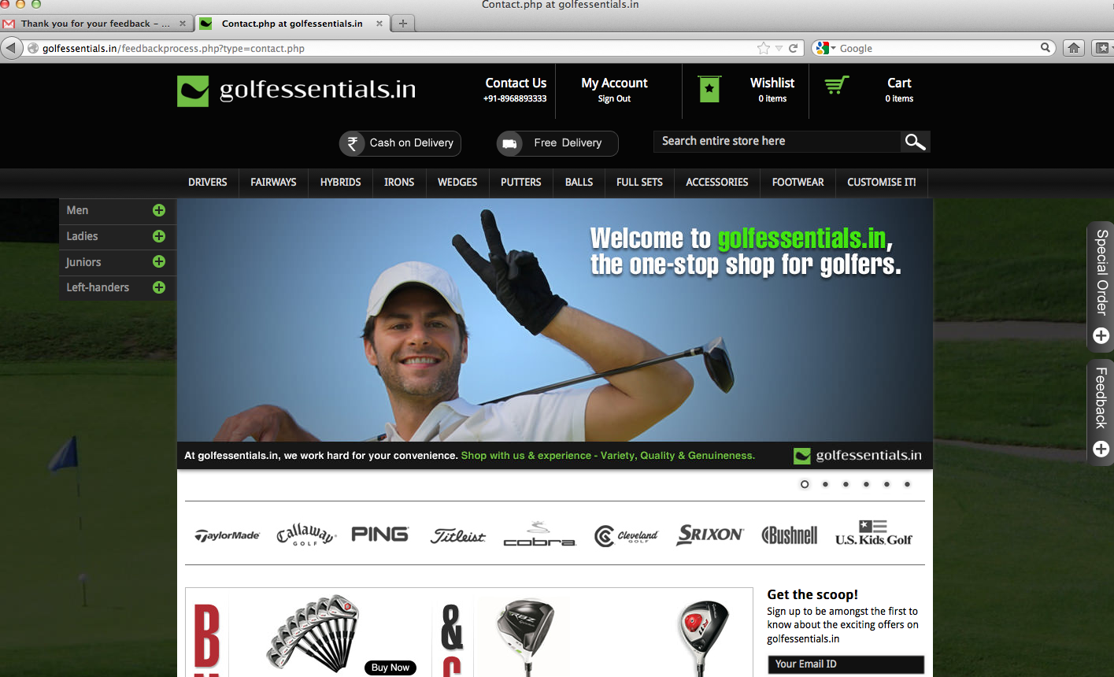
No message appearing…check the page title as well Corrected

Slide 15
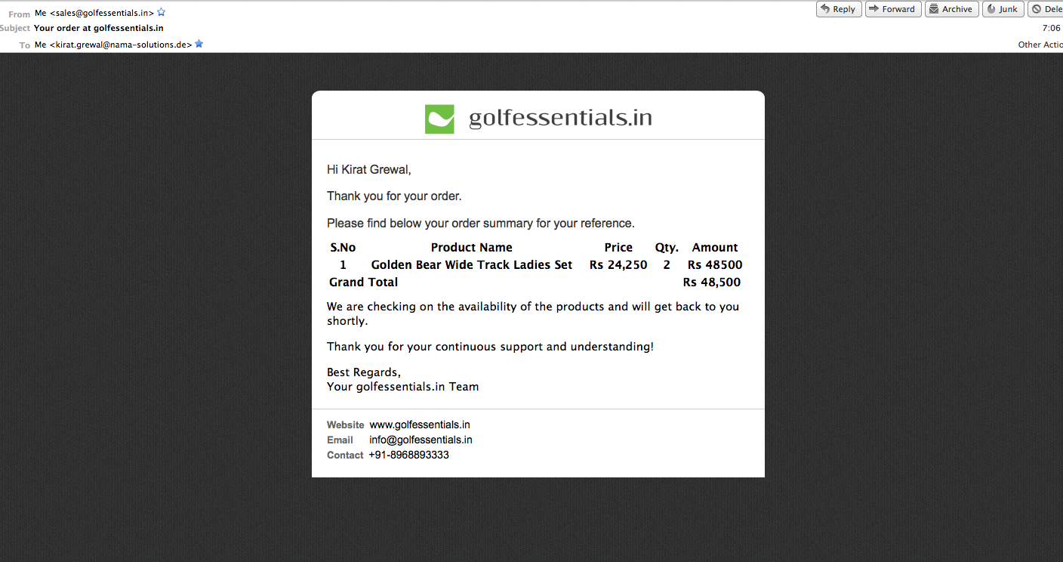
On receiving an order: From: sales@golfessentials.in Subject: Your order at golfessentials.in
No mail being received today (14 Nov) Working fine

Slide 16
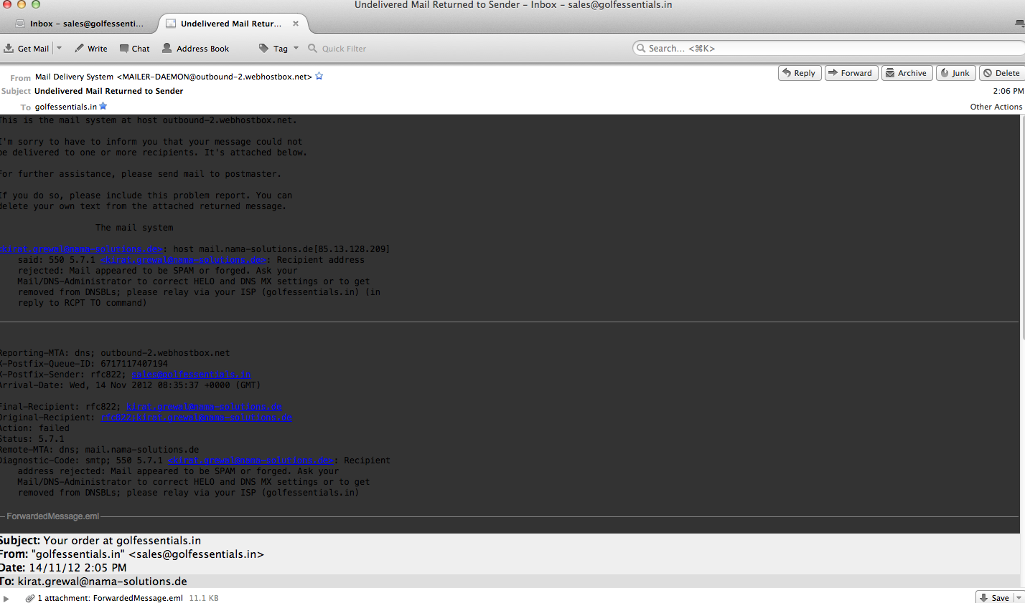
Mail received at sales@golfessentials.in (14 Nov)

Slide 17
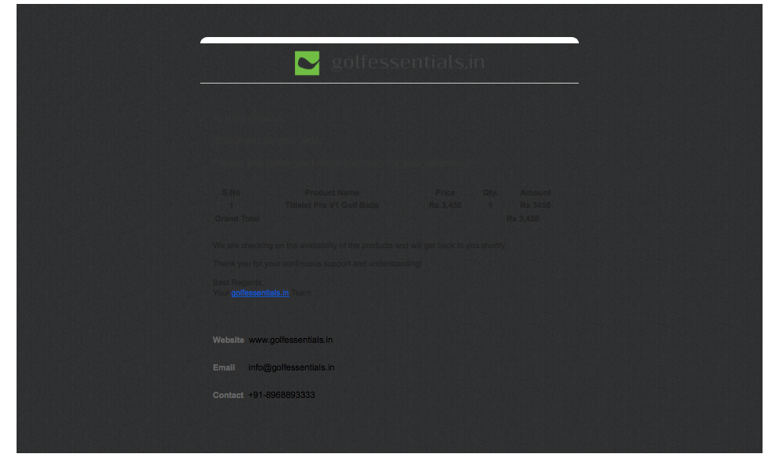
Email received on gmail today (Wednesday, 7 Nov 12). Couldn’t replicate it either !

Slide 18
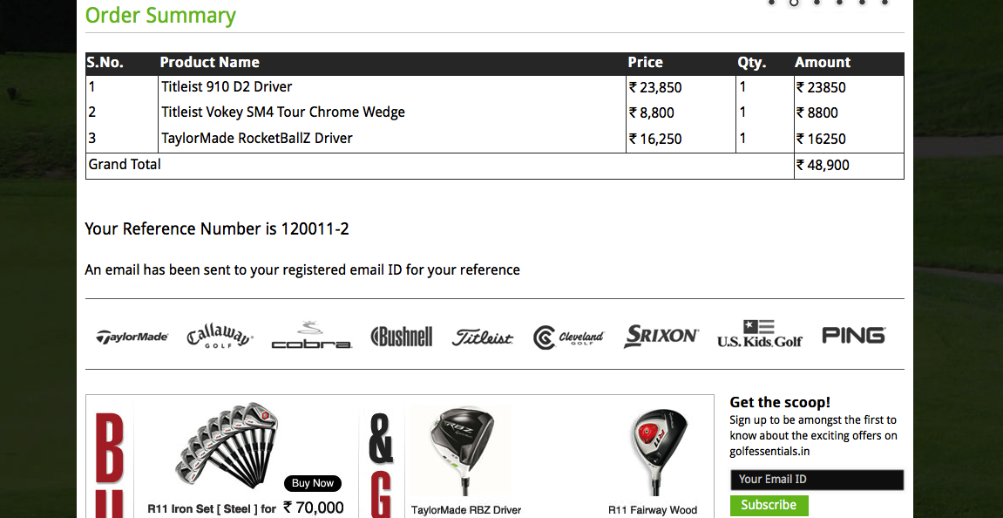
On the website
ok

Slide 19
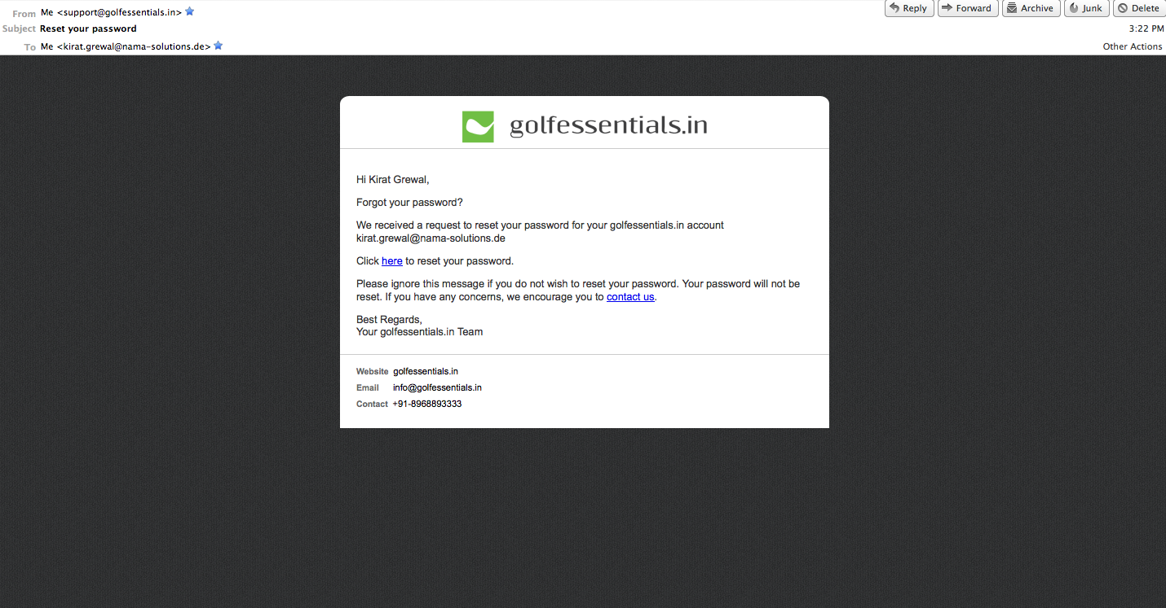
Forgot password: From: support@golfessentials.in Subject: Reset your password
No mail being received today (14 Nov). “Undelivered mail returned to sender” Works just fine here

Slide 20
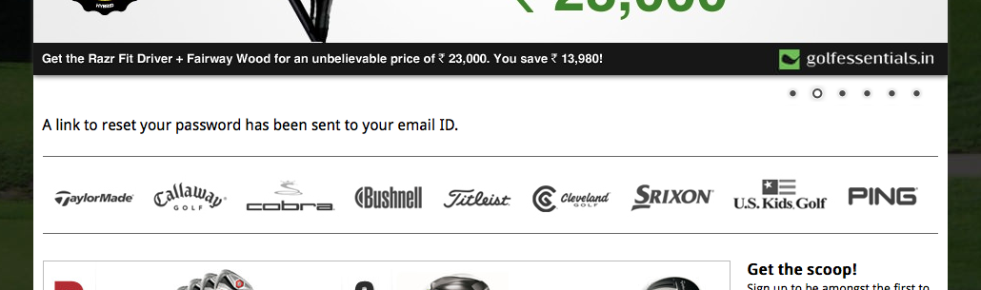
Add
Please feel free to contact us for any further assistance.
ok

Slide 21
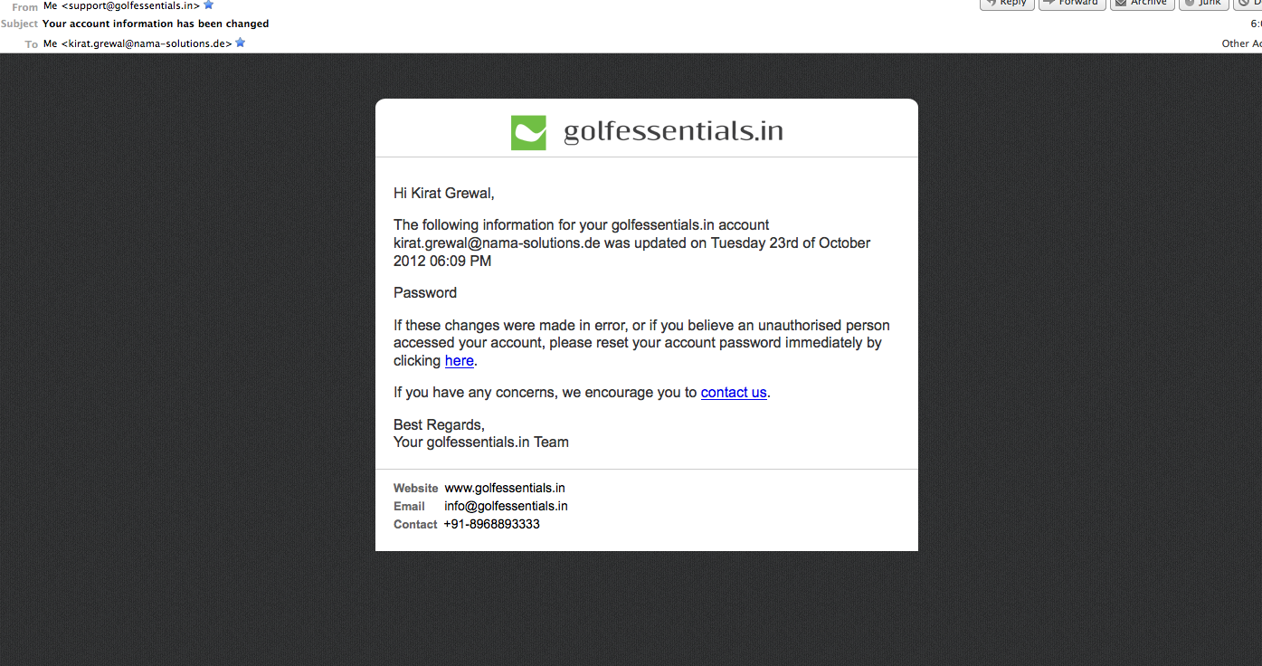
Change of account information: From: support@golfessentials.in Subject: Your account information has been changed
ok

Slide 22
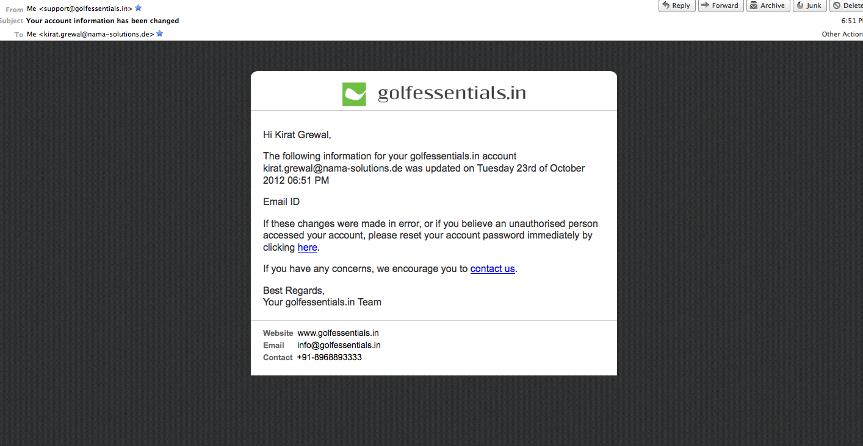
Change of account information: From: support@golfessentials.in Subject: Your account information has been changed
ok

Slide 23
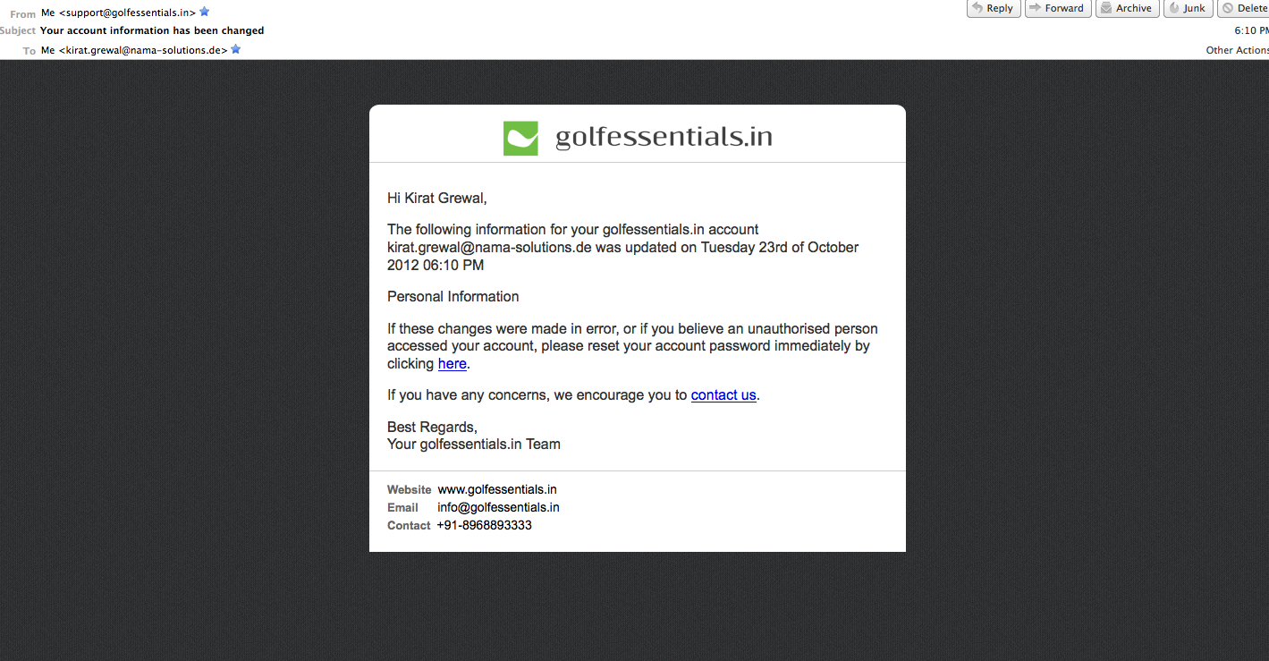
Change of account information: From: support@golfessentials.in Subject: Your account information has been changed
ok

Slide 24
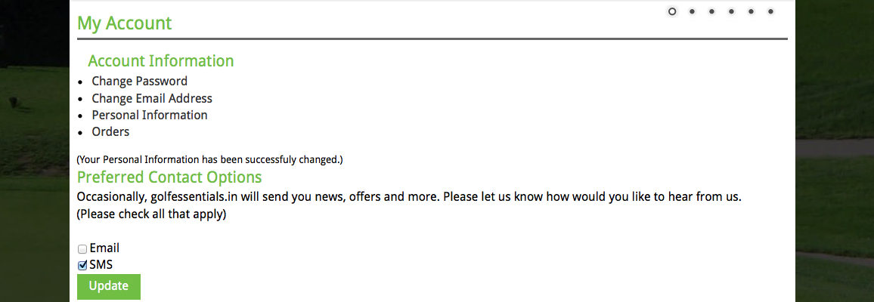
On the website
Should appear in bold
ok

Slide 25
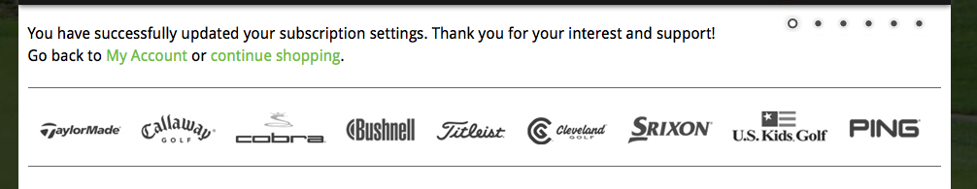
On the website – on updating preferred contact options
preferred contact options
Continue Shopping
Should be the same message for all combinations (whether one, both or none are checked) ok, both are checked by default right? Yes

Slide 26
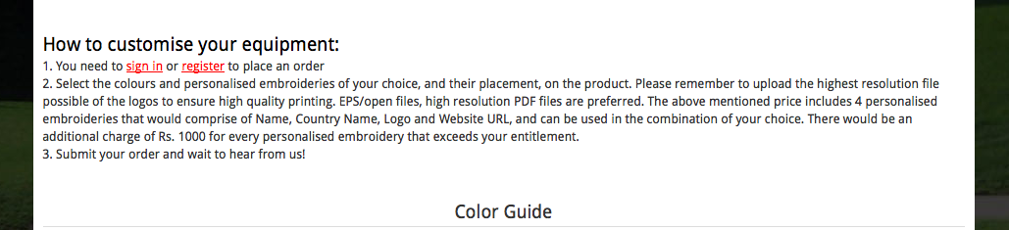
To be checked for each product this message does not have to be added there. You guys need to check the no. of embroideries that are possible for each product and put the no. accordingly. Isn’ that already there ? If not please elaborate !
This hasn’t been cut out yet DONE
Step (Step 1, Step 2, Step 3) ok
optimum quality output ok

Slide 27
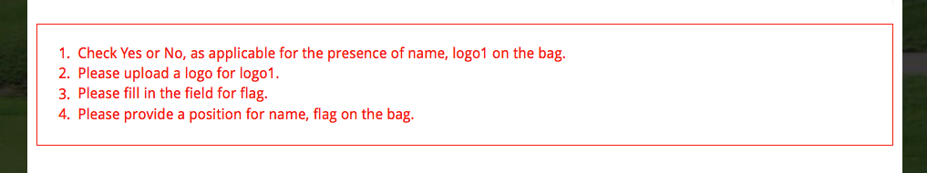
File DONE

Slide 28
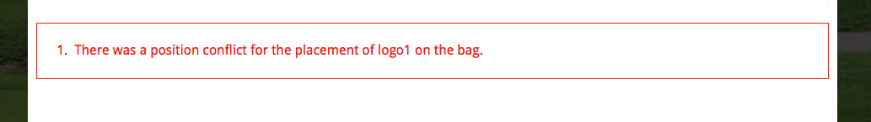
logo 1 & ___ on the bag – very extensive work, will do it tomorrow

Slide 29
Error Messages and notes
On selecting more than the possible number of embroideries:
Sorry, you can only select __ customised embroideries on this product
On entering a quantity less than the minimum order:
Sorry, the minimum order is ___
Note to be added where Price on request is mentioned:
(The price depends on the quantity and the complexity of the embroideries. You will be informed of the price shortly after you place your order. You will then have the option to confirm or cancel your order.)
ok

Slide 30
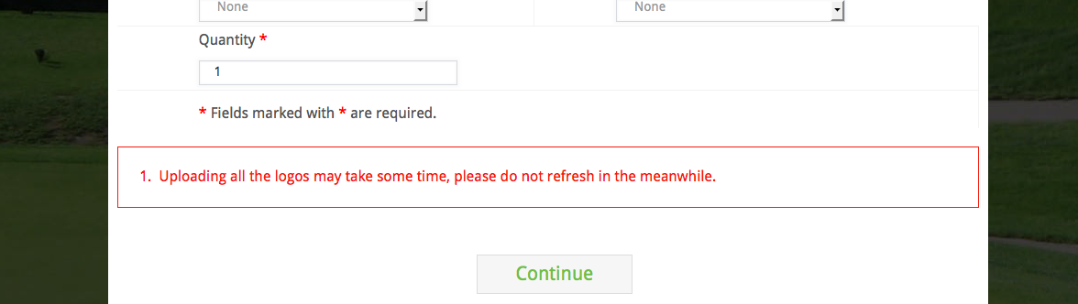
“It may take some time for your files to upload depending on your internet connection. Please do not refresh while the upload is taking place. Thank you!” (1 does not need to appear here)
Removed numbering altogether

Slide 31
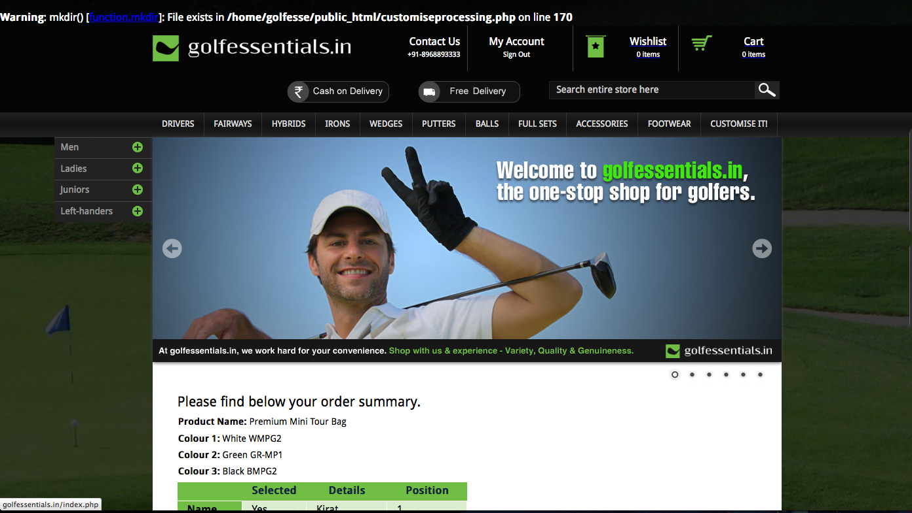

Slide 32
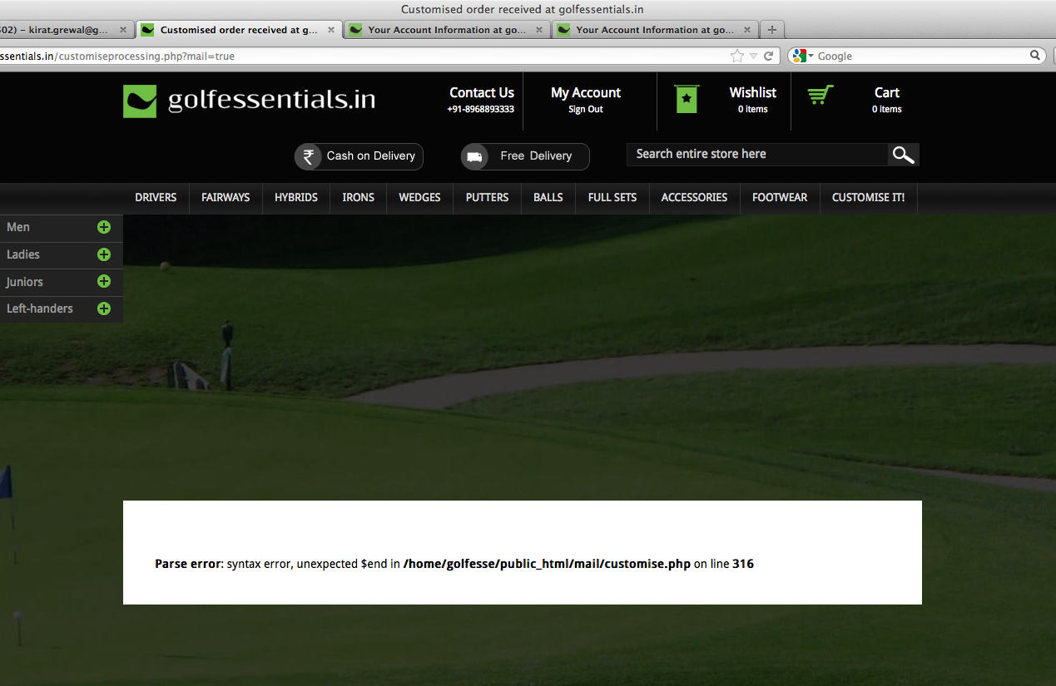

Slide 33
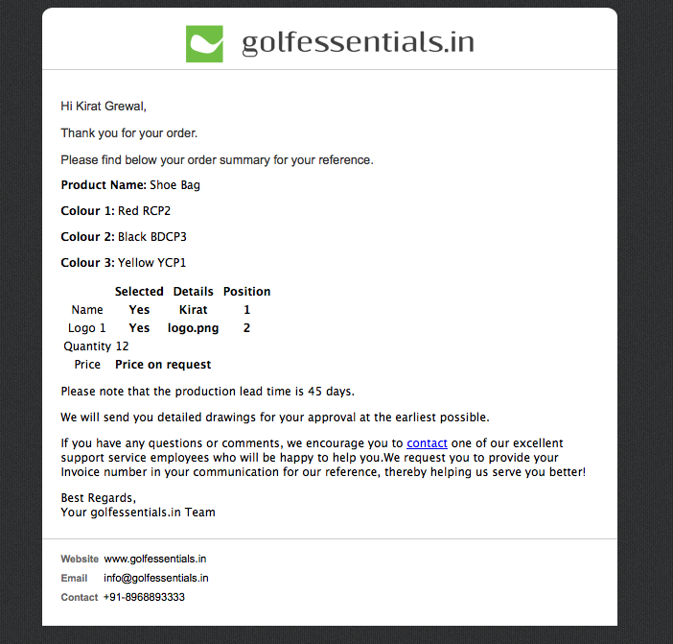
In case of price on request, please add the copy that I’ve put in green
This should be in bold as well
(We will get back to you shortly on this)
from the day you confirm your order.
shortly after we receive your confirmation on the price
add space
Could not check this as I am unable to place an order

Slide 34
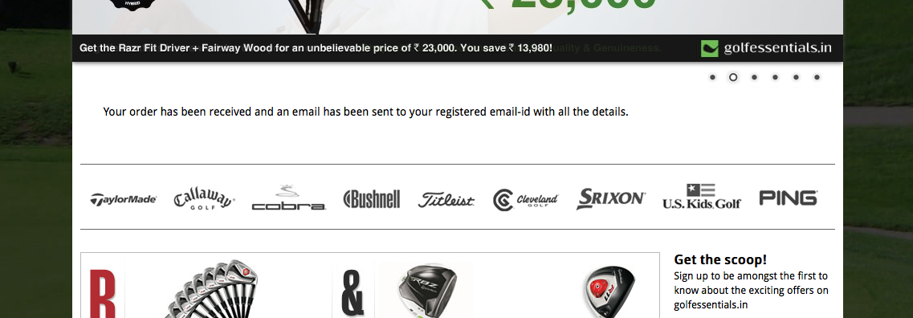
successfully placed
email ID with the order summary
Could not check this as I am unable to place an order

Slide 35
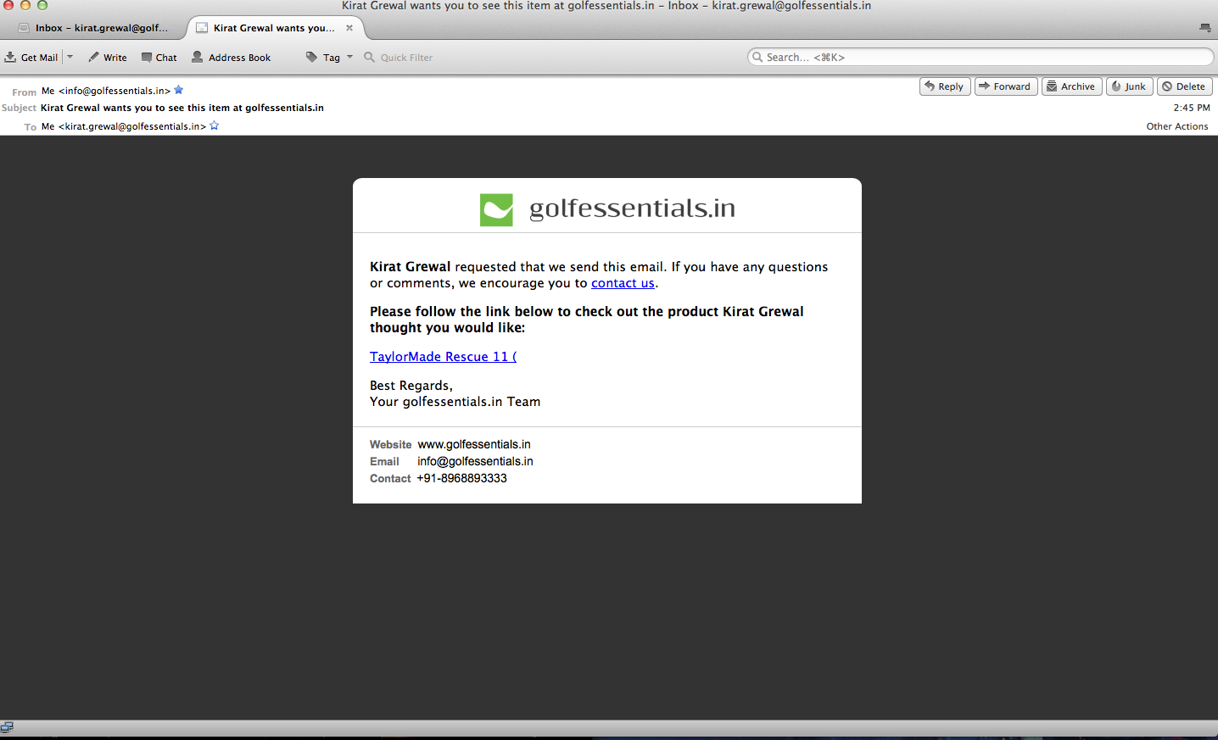
Share by email
From: info@golfessentials.in Subject: __ wants you to see this item at golfessentials.in
The complete product name should appear DONE

Slide 36
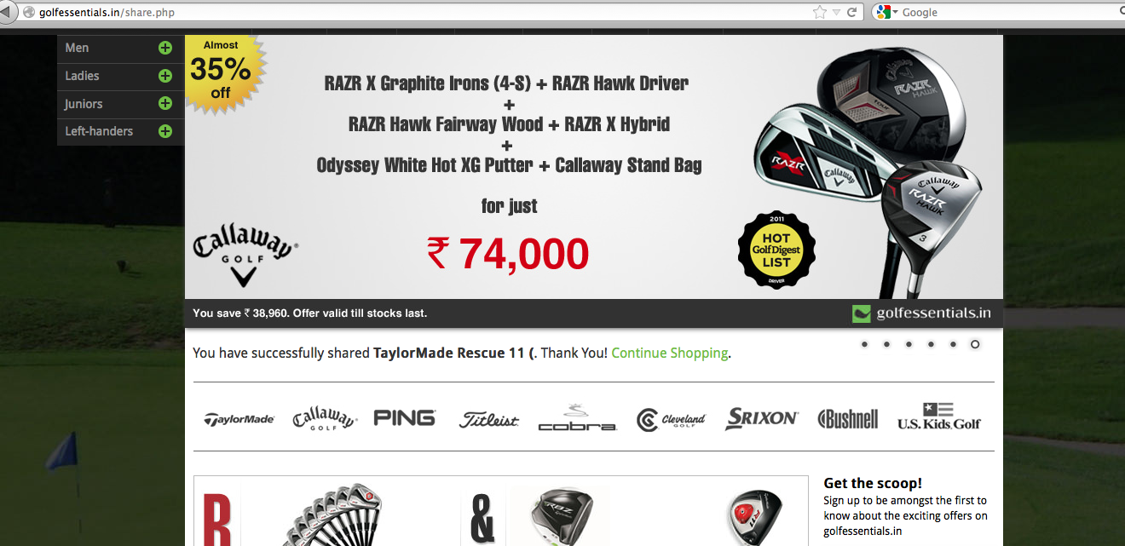
The complete product name should appear DONE

Slide 37
Emails yet to be worked on/pending review
Confirmation of availability
On dispatching products
Products have been in your wishlist for over 2 months
Unsubscribe
Promotional mail

